Slide 1
BLOCKCHAIN & DECENTRALIZED FINANCE
Recap…

Slide 2
Blockchain & DeFi – Day 2
Recap
We started the workshop with the motivation behind Decentralized Finance.
We discussed why Blockchain offers a good foundation to implement DeFi.
Using a simple ledger as an example, we understood the key security aspects of DeFi, like Encryption, Hashing, Public/Private keys.
Using MetaMask, we created first Wallet to interact with Ethereum and other blockchains.
I hope some were able to successfully acquire some SepoliaETH. If not, we will do so today.

Slide 3
Blockchain & DeFi – Day 2
Agenda
Bitcoin, the first distributed ledger.
Who runs the show?
Structure: Coin, Block, Transaction
Proof of Work (mining) and the Frankenstein it created
Input and Output Data Objects
Investigating a Bitcoin Transaction

Slide 4
BLOCKCHAIN & DECENTRALIZED FINANCE
Bitcoin, the first truly distributed ledger

Slide 5
Blockchain & DeFi – Day 1
Bitcoin
A digital asset, like a $1 bill, but exists virtually as a unique hash.
This hash is generated after solving a computational problem.
Nearly impossible to generate randomly or reverse-engineer.
Every Bitcoin transfer is recorded as a Transaction with a time stamp on a public ledger.
Every payment terminal can immediately confirm who the owner of each coin is by look at the digital signature.
Once a transaction is made, everyone in the network agrees that the transaction is valid and is qualified to be added to the ledger.

Slide 6
Blockchain & DeFi – Day 1
Who runs the show?
The Blockchain itself is decentralized, i.e. not hosted on a single computer.
The so-called computer Nodes are what make it decentralized.
Each node contains a complete copy of ledger.
Through a continuous verification and update method, every node is fully aware of the whole blockchain.
To compromise the blockchain, one must control more than half of nodes globally at the same time.

Slide 7
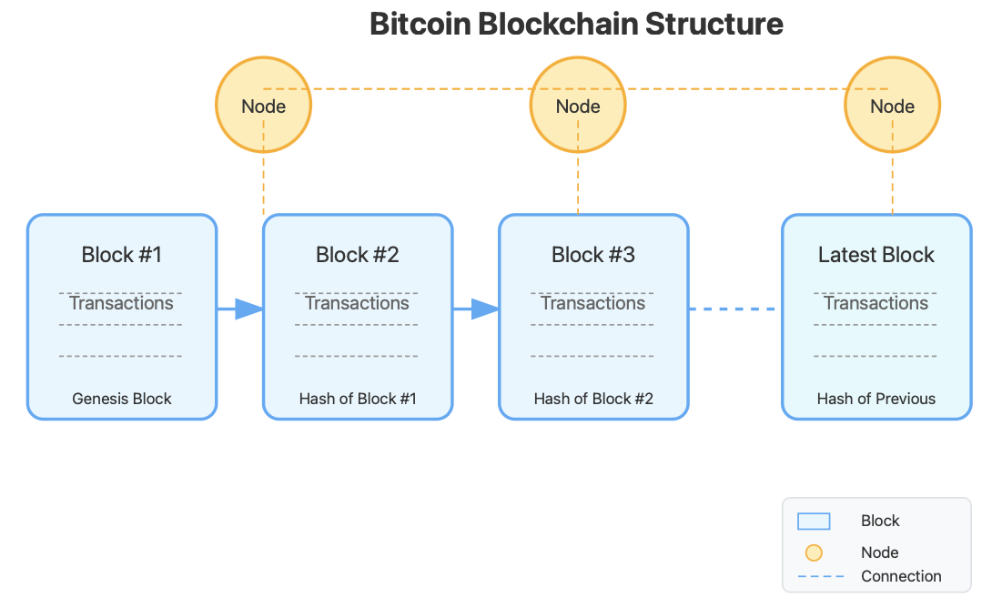
Blockchain & DeFi – Day 1
Structure
The foundation of Bitcoin blockchain consists of:
  Coins
  Blocks
  Transactions
  Proof of Work
  Input and Output Objects

Slide 8
Blockchain & DeFi – Day 1
Coin as conceptualized by Satoshi Nakamoto
A currency note has a serial number, not a unique random number.
If you know the last number, you can add 1 to it and print counterfeit currency.
The owner is the one who has physical possession, who may not be the legal owner.
A digital coin is a hash + collection of past transactions and digital signatures.
  Each owner transfers the coin to the next by digitally signing a hash of the transaction used to acquire it + the public key of the next owner.
  This way, the coin holds a trail of previous owners, and anyone can verify the entire chain of transactions and ownership.
  To restrict double spending, each transfer of ownership is publicly announced to the nodes.
The above is what Satoshi originally proposed, NOT how Bitcoin operates today.
Notes:
Think of it as a vehicle’s registration book. Every page specifies the ownership detail.
The description is of the original idea from Satoshi. Today, Bitcoin uses scripts and UTXOs (discussed ahead).
Practically, Bitcoin blockchain doesn’t have any digital object like Bitcoin # 123456. They are account balances.

Slide 9
Blockchain & DeFi – Day 1
Block
A collection of transactions.
The first block in a blockchain is referred to as Genesis block.
In January 2009, the Bitcoin network was created when Satoshi Nakamato mined the Genesis block.
0 BTC ($0.00) were sent in this block. Satoshi earned a total reward of 50.00 BTC $0.00.
Reward was paid as fees of 1 transaction which was included in the block. However, this reward is unredeemable.
Notes:
The first transaction of any block is called Coinbase transaction, which does not spend any assets. It is not a normal transfer of BTC from one person to another.

Slide 10
Blockchain & DeFi – Day 1
Understanding the first Blocks
An empty ledger cannot have a transaction like:
  Ali → 1BTC → Bisma
Satoshi started the Bitcoin blockchain and mined the genesis block:
  Block 0: Input = 0; Output = 50BTC
  The 50BTC was the reward of creating this block (non-redeemable).
  Now that we have a Block 0, its Block hash is a reference point to mine the next block.
Block 1: An independent wallet mined the block and earned redeemable 50BTC.
Block 2, 3, 4, … are created the same way. But wallets now have BTC, so these blocks will also have transactions.

Slide 11
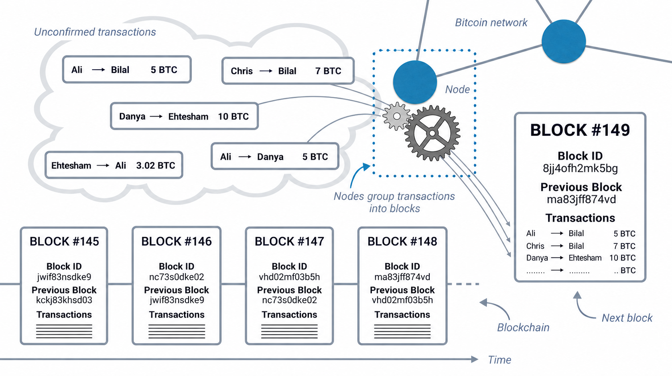
Blockchain & DeFi – Day 1
Notes:
The first transaction of any block is called Coinbase transaction, which does not spend any assets. It is not a normal transfer of BTC from one person to another.

Slide 12
Blockchain & DeFi – Day 1
Transaction
A transaction consumes one or more existing Unspent Transaction Output (UTXO) and creates one or more new UTXOs.
UTXO defines the state of Bitcoins in the blockchain, it has:
  Unique identifier of the transaction that created the UTXO
  Index or position of UTXO in the transaction’s output list
  Amount (value)
  Conditions under which the amount can be spent (Optional)
A transaction references existing UTXOs as inputs, but it creates outputs.

Slide 13
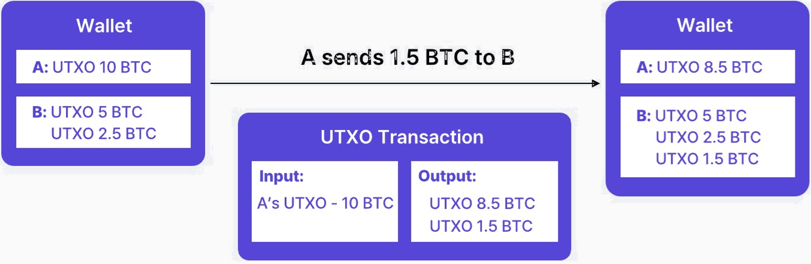
Blockchain & DeFi – Day 1
Transaction
A Wallet may have more than one UTXOs. Once they are spent, they no longer remain UTXO.
In the example, A made a transaction and spent 1.5BTC; his remaining UTXO is 8.5BTC
B had 5+2.5 UTXOs which became 5+3.5+1.5 after the transaction.
Notes:
Note! There is always some difference between Input amount and Output amount. That is the transaction fee.

Slide 14
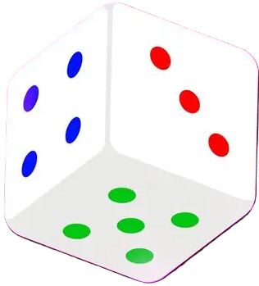
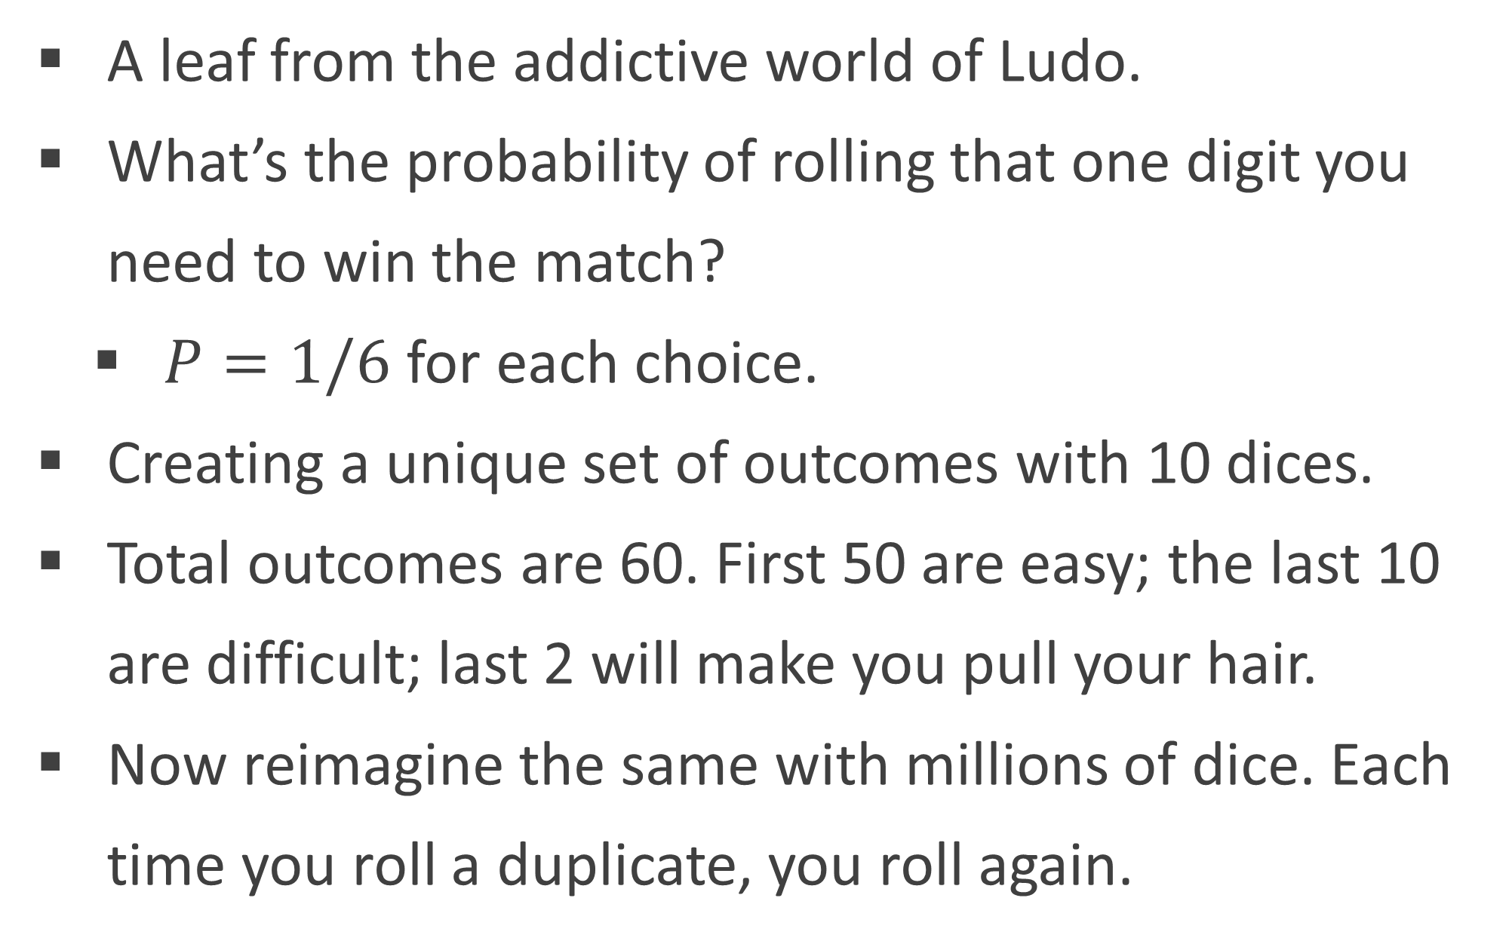
Blockchain & DeFi – Day 1
Proof of Work (mining)
A leaf from the addictive world of Ludo.
What’s the probability of rolling that one digit you need to win the match?
  $P=1/6$ for each choice.
Creating a unique set of outcomes with 10 dices.
Total outcomes are 60. First 50 are easy; the last 10 are difficult; last 2 will make you pull your hair.
Now reimagine the same with millions of dice. Each time you roll a duplicate, you roll again.

Slide 15
Blockchain & DeFi – Day 1
Proof of Work (mining)
Bitcoin mining: the process of repeatedly calculating the hash of a block header derived from transactions, until the resulting hash satisfies the difficulty target defined by the protocol.
Not every hash that is valid is accepted by the Bitcoin network. The PoW protocol imposes that the difficulty to compute hash be increased after every 2016 blocks.
If one hash is not accepted, some arbitrary number (called nonce) is added to the Proof of work function, and another hash is calculated.
The Proof of work is based on blind guesses, and to date, no reverse engineering technique or hack has proved effective against this mining mechanism.
Notes:
SHA-256: Secure Hashing Algorith is a function which generates a hash from given data.

Slide 16
Blockchain & DeFi – Day 1
The Frankenstein PoW created
PoW said: Spend computational resources to compete for the block reward. Everyone is welcome.
The arms race: CPU → GPU → ASIC → Mining farms → Industrial scale
GPU shortage amid COVID: everybody jumped into the bandwagon.
Resource wastage: CO₂ emission (39.8M Tn), electricity (138TW), water (1.65T Ltr.), hardware wastage (82% ASICs).
Laws of Economics won: late coming modest setups never saw ROI.
The problem: PoW gives all reward to the first comer; the one with most computation power becomes the first comer.
Notes:
ASIC: Application-specific Integrated Circuits.
The resource wastage is between the COVID era alone (end of 2019 to 2021).
As of today, 20M (>95%) BTC have been mined. However, with continuous improvement in hardware, the increase in difficulty is not affecting the operations significantly.

Slide 17
Blockchain & DeFi – Day 1
Bitcoin Nuances – details hidden beneath the simple model
The basic mechanism is established, but there are some unique features worth discussing.
  Locktime: prevents spending UTXO until a certain block number.
  Timestamp: always Coordinated Universal Time (UTC/GMT)
  RBF: Replace-by-fee flag is used by sender to replace with a higher-fee version.
  pkscript: ScriptPubKey; defines the conditions under which that UTXO can later be spent.
pkscript is Bitcoin's mechanism for expressing programmable business logic into transactions.
Notes:
Locktime can be seen as a postdated cheque, except the amount must exist.
RBF: If you set fee too low, you had to wait (sometimes forever). RBF was introduced so you could rebroadcast with a bigger fee, so miners prioritize your transaction.
PkScript is not optional, though it may appear so. For the least, pkscript field will enforce a condition like “provide a valid digital sign corresponding to this public key, otherwise the Tx will not be validated”.

Slide 18
BLOCKCHAIN & DECENTRALIZED FINANCE
Investigating a Transaction

Slide 19
Blockchain & DeFi – Day 1
Instructions
Visit: t.ly/CfXgA
Tx:22bb5dd2a88f9c5183df59aef20a44b8bce4a4056562b5d9cfff20a0ae2ffc1a
This is a consolidation + payment transaction. Spender combined three small UTXOs to send 0.0044 BTC to two recipients.
Can you calculate the amounts in $ and find out the exact fee Tx paid?
Recalling what Coinbase transaction is, can you find the total reward paid for the block this transaction resided in?
Notes:
0.0025956BTC were paid in fees (Ouch! congestion times).
Remember! total Coinbase reward = Block mining reward + transaction fees

Slide 20
BLOCKCHAIN & DECENTRALIZED FINANCE
Making the first transaction using MetaMask

Slide 21
Blockchain & DeFi – Day 1
Instructions
Visit: t.ly/CfXgA
Tx:22bb5dd2a88f9c5183df59aef20a44b8bce4a4056562b5d9cfff20a0ae2ffc1a
This is a consolidation + payment transaction. Spender combined three small UTXOs to send 0.0044 BTC to two recipients.
Can you calculate the amounts in $ and find out the exact fee Tx paid?
Recalling what Coinbase transaction is, can you find the total reward paid for the block this transaction resided in?
Notes:
0.0025956BTC were paid in fees (Ouch! congestion times).
Remember! total Coinbase reward = Block mining reward + transaction fees

Slide 22
Practical Exercise/Demo
Next Week…
Shortfalls of Bitcoin that Ethereum fixes.
Ethereum blockchain and its structure.
Logs and Events.
Proof of Staking and why it wins.
Why Ethereum is the right platform to develop a Finance ecosystem.
Ethereum nodes and how to set one up.
Should IBA have its own dedicated Ethereum node?

